Slide 1
Presentation at the Mississauga Central Library
November 18, 2017
Notes:
Reviewed 11 April 2018
(Use Page UP, Page Down to scroll through the notes in the Notes Page view)

Slide 2
Notes:
This is the book as it appears in Amazon.
buildingmississauga.com is my website with updates to the book and large excerpts available there
Here I can only signal the themes that I tried to discuss in the book.

Slide 3
Purpose of the presentation
It’s a case study of a new, postindustrial city,
in a rapidly growing agglomeration of Toronto
To study a new, knowledge based, economy
and its prospects in the coming 2 decades
Notes:
While doing research I had two main objectives in mind:
Mississauga is already one of the largest cities in Canada and yet we didn’t have a publication that would try to portray its present day issues.
Initially I intended to write a concise guide for potential overseas investors and immigrants, but gradually the work grew to a guide for everybody who would consider living or working in Mississauga and was interested in urban affairs. In this study, I was aiming at sorting out the dominant trends of development of Mississauga that will shape its future.

Slide 4
Main Themes
Mississauga and Toronto are growing rapidly
Mississauga’s population is aging
How do you move around in a big and dense city?
A knowledge based economy of Mississauga
Income polarization
The environment
Will there be jobs/work in Mississauga and Toronto in the 2030s?
Notes:
These are the main themes I tried to touch on in the book:
Mississauga & Toronto are growing rapidly: Mississauga is only 40 years old and already its population is over 780 thousand.
And Toronto has surpassed Chicago, now being the 4th largest city on the continent
(after amalgamation https://torontolife.com/city/toronto-fourth-largest-city/ Toronto pulled ahead of Chicago to become North America’s fourth-largest city behind Mexico City, New York and Los Angeles. According to estimates from Stats Canada and the U.S. Census Bureau, 2,791,140 people live in in Toronto, about one hundred thousand more than in Chicago (of course the metropolitan Chicago is still much larger than the GTA).
Aging of the society as a whole is a new phenomenon and we will talk about it in detail in the next slide.
How do we move around in a big and dense city? The transportation problems are perhaps the most widely discussed nowadays and we will have a look at the options available to us.
A knowledge based economy of Mississauga – Mississauga is not only a new city but also one sustained by a new, knowledge based economy. We will be talking about where people do find jobs at present and later on consider what issues they will be facing in the future job markets.
This new economy, however, is characterized by a troubling phenomenon that we call income polarization which means that this economy is rewarding a small group at the top while middle income jobs are disappearing and large sections of population are sliding into poverty.

Slide 5
Big cities are growing even bigger
In Canada we are increasingly living in big cities
One in three residents lives in Toronto, Montreal or Vancouver
Urban population is growing explosively world wide
In 2016 there were 31 megacities with a population of 10 million
or more
Notes:
We have already said that Mississauga and Toronto are growing rapidly. Mississauga in its four decades of existence has arrived at a point where mayor Bonnie Crombie already speaks of a city of a million people in the coming decade, or so.
August 9, 2017 video CTV interview
And the Greater Toronto Area (the GTA) is projected to be the fastest growing region of the province, with its population increasing by almost 2.9 million, or 42.3 per cent, to reach 9.6 million in the next 25 years (by 2041).
The Canadian population is increasingly living in big cities. At present already one in three Canadian residents lives in one of the three Census Metropolitan Areas of Toronto, Montreal, and Vancouver (p.45).
Large cities are growing even bigger, not only in Canada but worldwide. Already one in five people around the globe live in a city with more than 1 million inhabitants. Some of those urban regions are becoming megacities with 10 million inhabitants, or more.
Last year there were 31 such megacities with over 10 million residents, of which 24 are located in the less developed regions that were called the “global South”.
The big cities differ greatly between themselves. They have their unique histories and economies, ranging from rich to very poor. Yet they all offer valuable lessons helpful in understanding issues of big cities here in Canada.
Continue on the next page:

Slide 6
Mississauga is a post-industrial big city
it needs a walkable downtown
and an efficient public transit
Notes:
Also Mississauga has its unique characteristics. It is different from other Canadian cities, and so much more from the US cities across the border. Mississauga started as a post-industrial city, bypassing the industrial stage of development, that characterized Montreal, Toronto, and Buffalo or Detroit in the US.
In Mississauga there were no smokestacks characteristic for older industrial cities. The only ones belonged to the Lakeview coal fired powerplant that was demolished over a decade ago.
As Mississauga grows, we realize that it cannot continue to grow as a suburban community anymore, that it has to be planned differently.
To cut through a lot of literature, we would like to state that
in order to be livable, a big city needs a dense core served by public transit. In order to limit road congestion the future population increase in Mississauga requires densification and public transit. For the same reason the urban core needs to be walkable.
As we have seen in Toronto, ever more people living downtown are making the urban core very dense.
(BUT not all big cities are growing, some are shrinking, like Buffalo and Detroit just across the border).

Slide 7
The greying cities
In Ontario, in just 5 years up to 2016, aging baby boomers
meant 20 percent jump in number of seniors,
the biggest increase in 70 years
By 2041, the number of seniors aged 65 and over
is projected to almost double from 2.3 million,
or 16.4 percent of population in Ontario in 2016,
to 4.6 million, or 25.0 percent.
Notes:
The second theme I’d like to touch on is the rapid aging of the population in this country.
As stated in the slide, in Ontario, in just 5 years between the censuses the number of seniors increased by 20 percent.
And in the next two decades or so, the number of seniors aged 65 and over in Ontario is expected to almost double, to 4.6 million,
or 25.0 percent of the whole population.
This pattern holds also for Mississauga and has important implications for the future development of the city.
GOTO: Graph on Mississauga ages in 2041 [p.105 in PDF]

Slide 8
The aging population of Mississauga (projections for 2041)
Notes:
(Graph on p.105 in PDF)
When we look at the projections of age distribution in Mississauga some 25 years from now, we see that the city will be facing a very different outlook from today.
In the past decades we were used to an age distribution resembling a pyramid, where the largest part consisting of children and young adolescents constituted the base of the pyramid, while the elderly at the top were the smallest group. Now gradually the pyramid becomes reversed and the elderly become more numerous than people in the productive age. For example the projections indicate that around 2041, the women aged 75-79 will constitute the largest group in this city.
Why is the population of Mississauga and other cities aging?
It is mainly due to three factors: that people are living longer, and due to the fact that the post-war baby boomers are now retiring, which results in the falling birthrates and rising age averages.
https://beta.theglobeandmail.com/news/national/census-2016-statscan/article35861448/?ref=http://www.theglobeandmail.com&
CONTINUE ON NEXT PAGE:

Slide 9
One-person households have surpassed all other types of living arrangements
Notes:
Along with registering the aging of the population the last census also showed for the first time that the number of one-person households has surpassed all other types of living arrangements. Last year about 28.2 percent of all households were represented by singles, and that was more than the percentage of all combinations of people living together, that is more than the households of couples with children, couples without children, single-parent families, multiple family households and all other.
Why there were more single person households than those with all combinations of families? Because elderly people are more often widowed, and their children may have moved out. Also, because young people postpone starting families, and this is also due to the fact that more women are working and can afford living independently.
It is easy to imagine all sorts of problems arising in such a society. One of them is the fact that Mississauga is no longer a suburban locality for young families with children who prefer to live in single family dwellings. Young professionals and elderly singles have different needs than young families and they often prefer to live in multiple unit buildings with easy access to services and public transportation and this has important implications for city planning.

Slide 10
We need walkable cities
The traffic congestion back in 2008 cost GTHA $6 billion in total annual losses
By 2031, when the GTHA population is expected reach 8.6 million, congestion costs may amount to $15 billion a year
How do we move around in a big and dense city?
Because of congestion, less by car,
and more by transit, walking, and cycling
In Mississauga, and GTHA in general, we need to improve public transit. A lot is being planned: LRT, BRT, all day G0 trains,
but it is going to be expensive
Notes:
This brings us to the next question about livability of a city, the access to public transportation. We all are familiar with traffic horror stories from the highway 401 and other major roads in GTA. The 401 has gained the dubious distinction of the most congested highway in North America. About 70% of all goods produced in the country are moved along this corridor.
At the last count, back in 2008, the traffic congestion already cost GTHA (The Greater Toronto and Hamilton Area) $6 billion in total annual losses. And if we don’t act now, by 2031, when the GTHA population is expected to reach 8.6 million, congestion costs may rise to $15 billion a year, which would be choking the economy of the region.
So, how do we move around in a big and dense city?
Because of congestion, less by car, and more by transit, walking, and cycling.
Can’t we just build more roads? No, because it has been tried in the US and it didn’t work. The new roads encourage more traffic and quickly get as congested as the other ones. Besides, the highways built into the cores of some of the big American cities were devastating the downtown neighborhoods and made the downtown unattractive, causing loss of population.
For this reason big cities need to be increasingly walkable, with easy access to transit, like other world cities such as London or New York, or Hong Kong and Singapore, or Paris and Berlin. Or to some extent even like Montreal which has denser neighborhoods and more transit options.
Continued on next page:

Slide 11
Urban sprawl is unsustainable
Because of road congestion
Not enough tax revenue to maintain extended network of services
Unhealthy automobile based lifestyle
Expensive lifestyle – more cars needed
Environmental degradation
Social isolation of young people as well as the elderly
We need the Greenbelt
Those who prefer suburban living should pay the full cost of it
Notes:
What we have said about congested roads in GTHA is only the tip of an iceberg of unsustainable urban sprawl that causes all sorts of other acute problems.
The basic truth is that low density suburban neighborhoods do not generate sufficient tax revenue to maintain an extended network of services which now is subsidized by other tax payers. It’s often nice to live in an own house with a lawn and backyard but we have to face the fact that we are not paying for this convenience, because it is subsidized by all taxpayers, including those living in the dense downtown.
Another reason for unsustainability of sprawl is that far flung suburbs extend driving time and cause unhealthy automobile based lifestyle (we will be talking about it later).
By the same token driving for every errand in a suburban neighborhood requires more cars per household which is unduly straining the family budget in times when it is already stretched by rising housing prices and stagnating incomes.
Also, excessive driving causes environmental degradation by sacrificing prime farmland for roads and by increasing pollution.

Slide 12
The knowledge based economy of Mississauga
Mississauga has a strong knowledge based economy
with employment in:
advanced manufacturing, Health Sciences, Clean Technology, Information Technology, educational institutions, finance,
and a growing cultural economy
Mississauga generates surplus jobs
The city hosts Canada’s largest airport
Notes:
Mississauga has evolved into a big city that generates more work places than it has employed residents, about 420 thousand in total. It is supplying employment opportunities for other municipalities. According to availability of jobs, in September 2017 Mississauga was quoted as taking the sixth rank among large cities in Canada and the first in Ontario.
The city has attracted many large companies including about 1,400 multinational firms as well as 73 of the largest United States corporations, the so called Fortune 500 companies. It also has over one hundred Japanese companies located here.
Because Mississauga is a new city, it has developed a strong knowledge based economy with people working in advanced manufacturing, health sciences, in Information Technology sector, educational institutions, finance, and also in a growing cultural and leisure sector that provides entertainment opportunities for its residents, and which is profiting from the strong Toronto cultural centers.
About 1/3 of all employed in Mississauga contribute to the knowledge based economy
with many highly skilled and well paid jobs which in turn sustain other jobs in the city.
According to Enrico Moretti, an American economist, one additional Information Technology job generates close to five other jobs and helps to sustain the economy.
Continue on next page:

Slide 13
The emerging Silicon Valley North along the 401 and the Technology Triangle of Waterloo, Kitchener, and Guelph employ 280,000 IT workers
The Eastern alliance of New York and Toronto competes with Silicon Valley
Notes:
And increasingly we are hearing of the Silicon Valley North, stretching along highway 401 that is connecting Toronto and Mississauga with the so called Technology Triangle of Waterloo, Kitchener and Guelph, that employs about about 280 thousand IT specialists (which is already comparable to the Silicon Valley in California with about 380, 000 IT workers).
In addition, Mississauga is home to the Pearson airport, the largest in the country, which is not only a major employer but also a facilitator in maintaining international economic ties, important for the multinationals.
While Toronto remains dominant as a financial, administrative, research, and cultural center, Mississauga also has all of them, and has an edge in advanced manufacturing as modern plants find needed space there.
In manufacturing, Food Industry is Mississauga’s largest employer now, and the Financial Sector has become the largest employer in the knowledge based economy with a workforce of about 41 thousand in 2016.
In 2014 the IT sector in Mississauga was comprised of more than 1,350 businesses.
Employment in other sectors: Life Science 25,000+ (including 18,500+ for Life Science and 6,300+ for digital health enablers). Aerospace 24,000+, Automotive 12,000+, Finance, Insurance and Real Estate 34,000+. Information and Communications Technology 50,200+.
However, in developing the knowledge based economy, Mississauga is facing international competition for attracting innovative businesses. Manufacturing companies consider investing around the globe now, where labour force is less expensive. But large international knowledge based businesses that are the most productive, are looking for cities with good infrastructure, qualified workforce, and good quality of life which has implications for city planning.

Slide 14
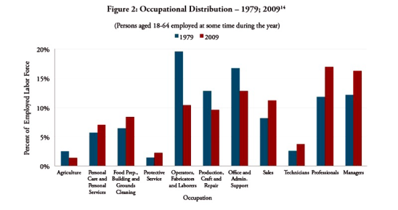
Income polarization in the US
Income polarization happens
due to disappearing middle income jobs
Notes:
Despite its strength, the new knowledge based economy does not benefit all segments of the population. While capital owners and highly skilled knowledge workers are handsomely rewarded, medium skilled workers in the traditional manufacturing are losing jobs
and are destined for low paid, insecure service jobs, if any at all. This leads to a worrying phenomenon of income polarization, where middle income jobs tend to disappear and where whole neighborhoods slide into poverty.
The middle income jobs tend to disappear in other developed economies as well.
This graph shows American data over three decades where middle income jobs were shrinking.
The orange bars in the graph represent 2009 levels of employment in various occupational categories, compared to 1979, represented by blue bars.
Occupations in the figure are listed from left to right in an order of increasing average pay.
The diagram indicates the degree to which occupational distribution has hollowed out: occupational shares at either end of the distribution have increased while occupational shares in the middle of the distribution have declined.
(The income polarization understood as continuous wealth concentration in advanced societies is the main topic of Thomas Piketty’s book Capital in the 21st century. See my Updates April 2018 section in the webpage).
Continued on next page:

Slide 15
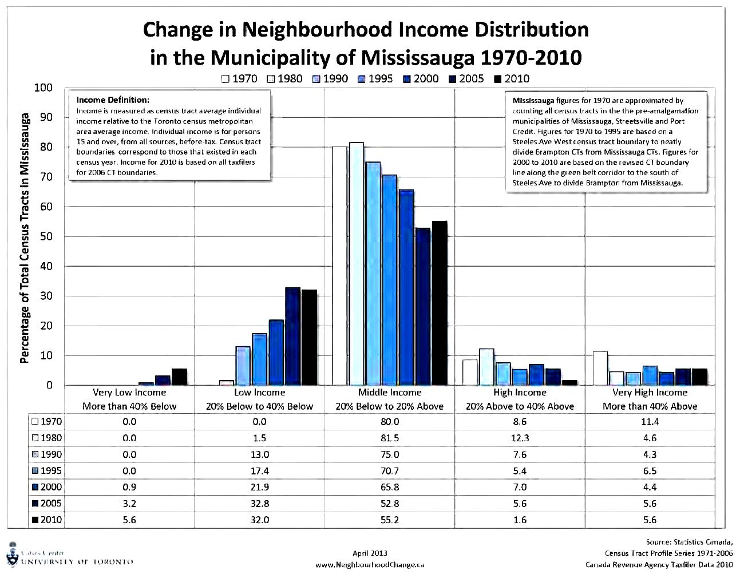
Income polarization in Mississauga
Polarization of income causes whole neighborhoods slide into poverty
Notes:
These data refer to neighborhood average incomes in Mississauga, as compared to Toronto average income between 1970 and 2010.
Middle income neighborhoods in Mississauga have shrunk from 80% in 1970 to 55.2% in 2010, while Low Income neighborhoods have risen from 0% , (that is none) in 1970 to 32% in 2010.
As Mississauga becomes a big city, we are creating an island of wealth surrounded by poor suburbs – stated David Hulchansky of University of Toronto who conducted the research.
People who are forced into these low income neighborhoods, either by loss of income or by rising housing prices in the central parts of the city, face an environment with poor transit options and limited services which limits their options to find better jobs.

Slide 16
Mississauga’s endangered environment
In the 2010s it is impossible to talk about a livable city
without considering its rapidly changing environment
Mississauga’s air quality has improved
since closing of the Lakeview coal fired power plant
More cars mean more exhaust pollution,
especially close to busy roadways and on highways
An autobased lifestyle contributes to obesity, diabetes,
and other serious illnesses
Global warming may trigger processes that escape human intervention
Notes:
Our next theme is the environment. At this point I would like to turn to the topic that is widely discussed, or controversially dismissed, which so far has not been included in the standard considerations for urban planning.
In this decade we have realized that it is impossible to talk about a livable city without considering its rapidly changing environment. Drivers fretting about traffic jams sometimes do not make the connection that they are experiencing an environmental issue, that congested roads also mean increased pollution by automobile exhaust.
Years ago, in Toronto we had about thirty smog days annually when people were advised to limit activities in the open air. Now the air quality has improved because of closing the Lakeview coal fired power plant in Mississauga in 2005. We need to acknowledge that Ontario is the first territorial government in North America that has gotten off coal fired utilities.
Nevertheless, the number of cars on the roads keeps rising which also means increasing exhaust pollution; especially close to busy roadways and on highways. And many more automobiles are coming with the expected population increase.
Apart from the pollution, autobased lifestyle contributes to health problems, especially to obesity and diabetes. In Malton, near Pearson International Airport, between 12 and 22 of every 100 adults already have diabetes.
Continued on next page:

Slide 17
Global warming:
Al Gore’s An Inconvenient Sequel
Global warming causes erratic and extreme weather patterns
Renewable energy is a viable option
Notes:
These environmental concerns lead us to the issue of global warming, which is less obvious than the traffic jams but so much more dangerous in the long run.
Increasing automobile exhaust pollution worldwide contributes to global warming which is now reaching alarming proportions. If not contained, in a few decades the warming of the atmosphere and the oceans may trigger processes that may escape human intervention and make large parts of the globe uninhabitable.
Some people still don’t believe in global warming, or don’t want to acknowledge it due to vested interests, as sometimes representatives of the oil and automobile industry do. But people who had a chance to watch Al Gore’s movie: An inconvenient sequel, which was launched in Toronto in 2017, saw a lot of evidence showing that the climate is warming and what it means in real terms in countless examples around the globe, including in major US cities. They point to the fact that with more heat energy in the oceans and atmosphere violent storms are becoming more likely and more dangerous. The devastating hurricane season of summer 2017 is a case in point.
But perhaps equally important is the message that there are ways to limit environmental pollution and that substituting carbon based fuels by renewable energy is a viable option.
Already several cities in the US are generating electricity by wind turbines and solar panels that fully covers their needs. On January 1st, 2018, a milestone was reached, whereby for the first time in history the entire Germany was supplied by electricity from windfarms. (See the web section: Updates April 2018).
The technological developments of recent years drive down the costs of renewable energy and make it comparable to other sources of energy.

Slide 18
Work in the 2030s
Will there be work in Mississauga and the GTHA
in 2030s?
Automation will continue replacing manual work
in the factories and in the services
Intelligent Automation will erode professional work
Work increasingly will be created
by innovative entrepreneurs and the self employed
Notes:
Now I would like to turn to my final topic considered as a vital part in discussions about livability of this city and urban region as a whole and ask about the future of the labour market in the coming two decades.
We are talking here about the perspectives of finding work by all those in their 50s now who are looking forward to their retirement, as well as for generation born in this decade that will be expected to enter the labour force in the 2030s.
The reason I chose a perspective of 15 – 20 years from now is that by then we expect new intelligent automation technologies to be introduced that will dramatically affect the opportunities for work. The expectation is that in about 2 decades they will not only eliminate most of the manual work in the factories but also will be eroding services and white collar jobs, including the most qualified professional work.
Huge sums of money are sunk into developing Artificial Intelligence technologies in the advanced countries around the globe and the progress made is often astonishing. China alone is investing in Artificial Intelligence more than any other country except the US and even being ahead of it in Financial Technologies (the so called FinTech).
The International Monetary Fund reports that China will be able to produce 100,000 Made-in-China industrial robots annually by 2020, along with another half a million or more (500,000) industrial robots (with six axis) with increased flexibility). Foxconn, the Taiwanese electronics maker and a leading manufacturer of Apple’s iPhones, has already replaced 60,000 factory workers with robots in its Chinese factories.
Continued on next page:

Slide 19
The robotic Olympics of Tokyo 2020
ZZZZZZZZZZZZZZZZz
Notes:
As an example of the feverish race into robotics may serve preparations for Tokyo Olympics of 2020 when the Japanese want to showcase their robotic achievements: they promise humanoid robots greeting guests at the airport and the hotels, giving instructions in ten languages with automatic natural language translation and hailing self driving cars that would take the visitors around the Olympic Village. The reason for this push for intelligent automation is that in a global economy countries that win the race stand to reap huge rewards.
The concern is that with those technologies the job market will be shrinking and will leave even many well educated people without opportunity to work. Even if automation will create new jobs it is feared that they will not replace all the jobs eliminated in the near perspective. Recent research (December 2017) by the McKinsey Global Consulting team Jobs lost, jobs-gained indicates that in countries like the US and Canada, about 23% of working time would be eliminated by automation by 2030. (See the web section: Updates April 2018).
In order to limit the future shock discussions should be directed at ways to educate the new workforce and at developing safety nets for those who despite their best efforts will not be able to secure adequate income for themselves and their families.
The new, intelligent technologies will be exciting for consumers offering easier access to practical expertise but will be destructive for traditional service providers, especially traditional professionals who will be losing work regardless of their levels of education. These technologies will not be bound by professions’ exclusive areas of expertise. The new, “Watson” type technologies will be providing individually tailored practical solutions to individual needs often spanning several professions. Those expert systems may be very expensive to build, but once launched will be able to serve extra customers at minimal cost (as in case of extra students subscribing to a MOOCS a massive-open-online-course of studies).
We are not sure what the future professions of an Internet era will look like, except that we know they will be vary different from those we know at present. One of the practical questions being how to train young professionals so that their knowledge will not be rendered useless by the future Watson type technologies.
In order to limit the future shock discussions should be directed at ways to educate the new workforce and at developing safety nets for those who despite their best efforts will not be able to secure adequate income for themselves and their families.

Slide 20
Preparing for the future
Addressing traffic congestion and hazardous pollution
requires densification of urban core, improving public transit
and walkability of urban centers
We need to plan for a society with fewer workers and taxpayers
and more elderly
Income polarization and technological unemployment
will require supporting entrepreneurial skills
and building safety nets for the underemployed
We need to reduce pollution by supporting renewable energy

Slide 21
Invitation to discussion
To close file click Alt+F4
Notes:
Many researchers are concerned that the tendency of income polarization will only be reinforced by the coming revolution of intelligent automation technologies expected to come on the market in the coming decades. These new technologies are expected to erode also highly skilled white-collar professions and cause technological unemployment. While many new positions will be created they will not replace all the jobs lost to automation. This situation will require new ways of education of the future workforce as well as creation of new safety nets for the underemployed and underpaid population.
My hope was that this book will contribute to the ongoing discussion of the future challenges of the city building in the new economy.

